Slide 1
A COST EFFECTIVE SOLUTION FOR THE REAL TIME SIMULATION OF MERCEDES-BENZ’S KEYLESS-GO SYSTEM’S DOOR HANDLE ON A HARDWARE-IN-THE-LOOP-PLATFORM

Slide 2
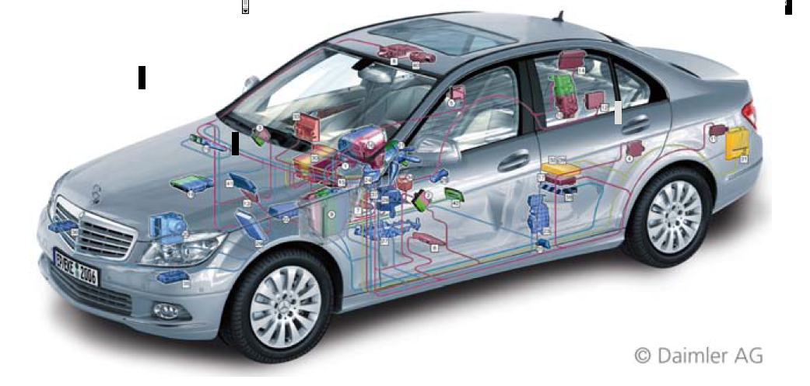
Area of work
This work revolves around HIL systems designed custom to the requirements of Mercedes Benz. The Keyless Go ECU, one of the several ECU’s installed in a Mercedes-Benz vehicle, is required to be tested in a variety of scenarios on a Hardware-in-the-loop platform, to attest it’s functionalities and it’s robustness. The door handle is one of the components that communicates with the KG-ECU.
This work attempts to come up with a cost effective solution for the real time simulation of the Door Handle on a KG-ECU installed HIL platform.

Slide 3
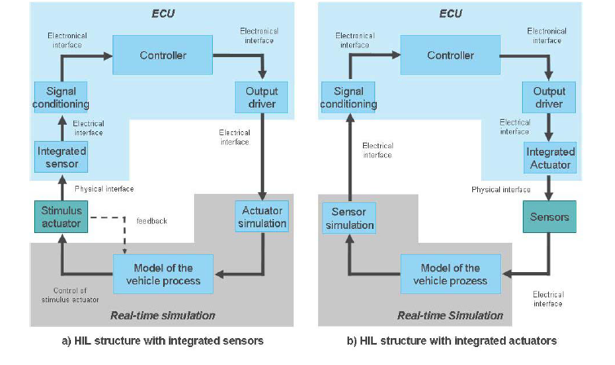
Present day scenario
Hardware-in-the-loop simulation is a method used in the product development cycle in which one or more real components interact with components that are simulated in real time (dynamic models).
The simulated subsystem has to perform the following actions within one simulation step:
Read in the measurement signals (actuator control by the ECU)
Calculate and perform numeric integration (simulate the entire dynamic model of a real system)
Output the results (sensor simulation for the ECU).
The result is a closed loop between the real controller and the simulated plant.
The Figure shows a signal flow that illustrates this structure. In the real system, the real ECU is integrated in the real vehicle (left); in HIL simulation, it is connected to the HIL simulator via electrical interfaces (center and right).

Slide 4
Motivation
The major aims of HIL simulation are to enhance product quality, to master complexity, and to reduce development costs. This last aim is achieved by moving function tests and diagnostics tests from tests drives or test bench experiments to the HIL laboratory. HIL tests can be reproduced as often as required and also automated.
HIL simulation makes it possible to give an ECU an environment that is so realistic that the ECU's diagnostics system does not detect any inconsistencies in the electrical signal quality or the dynamic behavior of the plant (no fault memory entry by the diagnostics). In this situation, any tests that would typically be performed in or with the vehicle (or on a test bench) can also be performed on the HIL simulator.
The door handle simulation will be conducted on the HIL platform using a special purpose interface card. This card will be designed and programmed to act as an interface between the HIL system and the ECU under test. The entire project revolves around understanding the HIL system and the Keyless-Go system design of Mercedes Benz and the subsequent low cost solution to design and implement an interface card.

Slide 5
HIL Systems: Basics and Components
Hardware Components of the HIL System:
Host PC
Real-time processor system
I/O boards and signal conditioning
Bus systems
Electrical loads and load simulation
Electrical fault simulation
Real components
Power supply
Software Components of the HIL System
Operating Software (Implementation and Experiment Software)
Real-Time Software
Dynamic Models

Slide 6
HIL Application Areas
HIL systems are employed for testing single ECUs and ECU networks. Single ECUs are frequently tested thoroughly by their supplier before they are delivered to the car maker - the original equipment manufacturer (OEM) - for integration.
The OEM then performs comprehensive network tests on all the ECUs together.

Slide 7
Interface Card for Simulation
A basic difference between electric machines and other vehicle components is that the machine is controlled at a very high clock rate (typ. 10 MHz in this case). This makes high demands on the HIL simulation. I/O sampling rates in the millisecond range and mean value models, which are used for combustion engines, are not sufficient for fast current and position control. Special FPGAbased hardware is needed for this. Figure below shows a generic FPGA board that can be equipped with application- specific modules, e.g. for measuring the PWM control signal or for simulating incremental encoders or resolvers (clock rate 40 MHz). Moreover, small model parts can be simulated directly on the FPGA to achieve simulation step sizes in the sub-μs range.
This work focuses on the design and implementation of an interface card to simulate the door handle in the Keyless-Go ECU based HIL system. The door handle sends a special telegram to the Keyless-Go ECU that encodes various functions and commands, at a rate of about 10Mhz, or more. To implement this speed and accuracy, a fpga based card will be implemented to integrate with the HIL system.

Slide 8
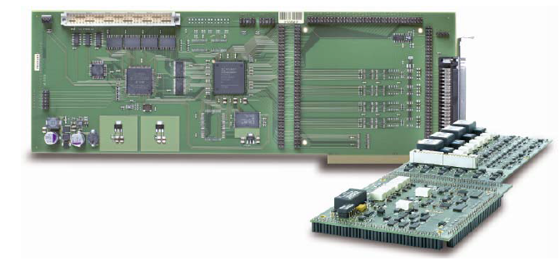
Generic fpga based Interface card

Slide 9
Integrated Sensors and Actuators
There is generally an electrical interface between the ECU and the (simulated) actuators and sensors. In this case the wiring harness can simply be opened up and connected to the simulator.
However, if the ECU has integrated sensors or actuators, the interfaces between the ECU and the HIL system are at different locations.
Integrated sensors and actuators are frequently used in transmission ECUs that are installed directly in the automatic transmission. For HIL simulation, the integrated sensors must be stimulated physically, e.g. inductive speed sensors are stimulated controlled coils, pressure membranes by strong lifting magnets, and temperature sensors by controlled hot plates.

Slide 10
electrical interfaces are replaced by physical interfaces

Slide 11
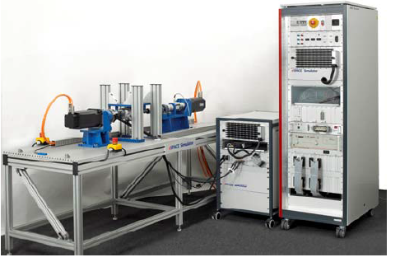
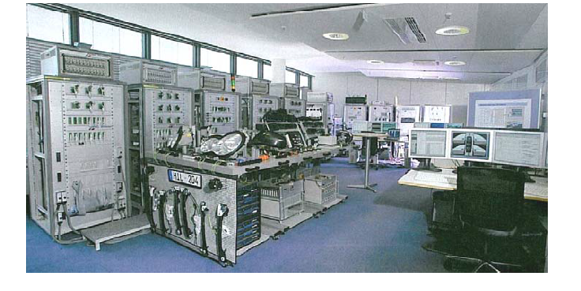
Test Bench Integration
It is important to test an entire mechatronic subsystem such as a steering system or a chassis on the HIL simulator in addition to performing pure electronics tests. Thus, fatigue tests have to be performed in addition to function testing. Classic mechanical test benches are coupled with HIL simulators for this. Figure below shows such a test bench for a steering system.

Slide 12
HIL test platform
Achieving a rapid vehicle development programme reduces cost and maximizes the impact of a new vehicle. Hardware in the Loop (HIL) systems are an important technology enabling integrated electronic control systems to be developed within the time frame defined by the vehicle development process and with a reduced reliance on expensive prototype vehicles.
An HIL test platform allows the integration of real control system hardware, a controller under test, with a simulation model representing the real environment in which the controller under test operates.
The simulation model, commonly called a plant model, is designed to be executed as compiled code on a target microprocessor that forms a part of specially designed HIL hardware. The HIL system also includes signal conditioning hardware that provides an interface between the controller under test and the virtual world of the plant model.

Slide 13
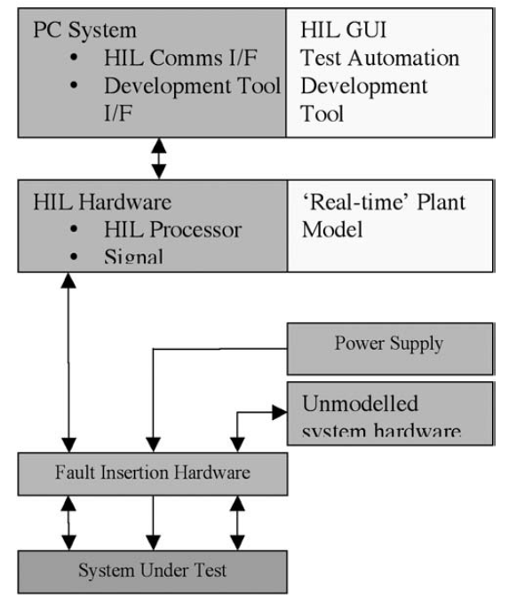
HIL test platform for ECU testing
Figure shows the HIL system used for testing control system software.
The system shows a PC that has a hardware communication device linking it to the HIL hardware. An interface between a development tool and the system under test is also installed to enable calibration and system data analysis to be carried out.
Also required is HIL user interface software, test automation software and model development software, such as Dymola/Matlab/Simulink, for plant model construction.
The use of automated test software enables repeatable tests, normally carried out manually by test engineers, to be executed on the HIL system.
Typical tests performed on an automotive ECU are short- and open-circuits on I/O that exercise ECU diagnostic software.
An important feature of test automation software is the ability to store test results and present them in a readable format that is easily analyzed.

Slide 14
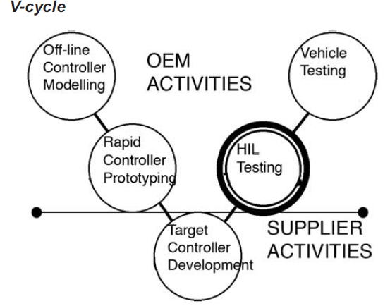
V-cycle controller development process
The approach largely adopted for control system development follows the stages defined by the V-cycle.
The process begins by defining a set of functional requirements for a system from which a simulation model of the control system is developed.
A rapid prototype phase follows whereby the control system can be embedded into a prototype platform in a vehicle.
The construction and verification of a controller model is followed by the development of the embedded code and the target ECU.
Following delivery of the ECU and software, HIL systems are used to carry out various forms of functional testing of the strategy and associated diagnostic routines.
The types of testing well suited to being carried out using HIL systems are those tests that are repetitive, such as testing for system failure modes.

Slide 15
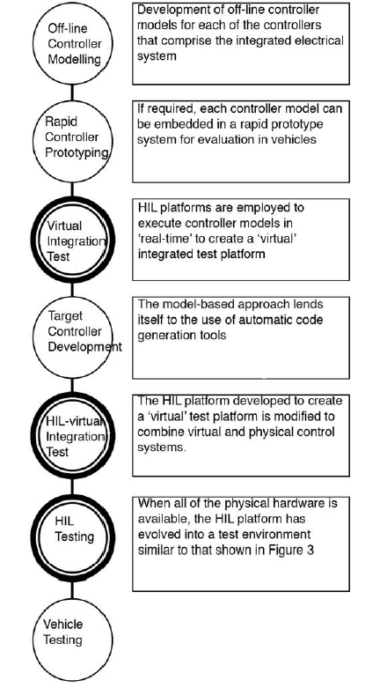
Combined HIL-virtual test and development platform
A combined HIL-virtual test platform has been built to support the development of an integrated body electronics system for a new vehicle. Taking a model based approach to the design of control system software has allowed HIL technology to be used to test system integration prior to having physical ECU hardware available.
The use of HIL systems for testing a combination of virtual and physical controllers allows more complete testing to be carried out earlier in the life of the vehicle development programme.

Slide 16
PROBLEM DEFINITION
➔ Cost Factor: Interface cards supplied by HIL system manufacturers such as National Instruments, DSpace, etc, are very expensive and delicate. This work focusses on trying to derive an alternative cost effective solution to RTPC - ECU interfacing.
➔ Ownership of IP: There is a benefit for vehicle manufacturers such as Mercedes-Benz to develop control systems independently of third-party suppliers. In addition to having ownership of the intellectual property that corresponds to a particular system, developing systems that differentiates their cars from those of competitors is important. Systems or features developed ‘in-house’, by engineers of the company, such as me, help to define the brand and this is important in a very competitive market. This is another reason behind the plan to design the interface card, in-house by me.
➔ Flexibility: The design choices and customizability will be in Mercedes- Benz’s control. Modifications in design due to future development in the particular system can be brought about relatively quickly and with more flexibility in design.

Slide 17
Intel - Altera MAX 10 Dev (FPGA + CPLD + NIOS II Soft Core)
Intel® MAX® 10s revolutionize non-volatile integration by delivering advanced processing capabilities in a low-cost, single chip small form factor programmable logic device.
Building upon the single chip heritage of previous MAX device families, densities range from 2K – 50K LEs, using either single or dual-core voltage supplies. The MAX 10 FPGA family encompasses both advanced small wafer scale packaging (3 mm x 3 mm) and high I/O pin count packages offerings.
MAX 10 FPGAs are built on TSMC’s 55 nm embedded NOR flash technology, enabling instant-on functionality.

Slide 18
system component functions
Dual configuration flash—A single, on-die flash memory supports dual configuration, for true fail-safe upgrades with thousands of possible reprogram cycles.
• Analog blocks—integrated analog blocks with ADCs and temperature sensor provide lower latency and reduced board space with more flexible sample-sequencing.
• Instant on—MAX 10 FPGAs can be the first usable device on a system board to control bring-up of other components such as high density FPGAs, ASICs, ASSPs, and processors.
• Nios® II soft core embedded processor—MAX 10 FPGAs support the integration of the soft core Nios II embedded processors, providing embedded developers a single chip, fully configurable, instant-on processor subsystem.
• DSP blocks—As the first non-volatile FPGA with DSP, MAX 10 FPGAs are ideal for high-performance, high-precision applications using integrated 18x18 multipliers.
• DDR3 external memory interfaces—MAX 10 FPGAs support DDR3 SDRAM and LPDDR2 interfaces through soft intellectual property (IP) memory controllers, optimal for video, data path, and embedded applications.
• User flash—With up to 736 KB of on-die user flash code storage, MAX 10 FPGAs enable advanced single chip Nios II embedded applications. The amount of user flash avalable dépends on configuration options.

Slide 19
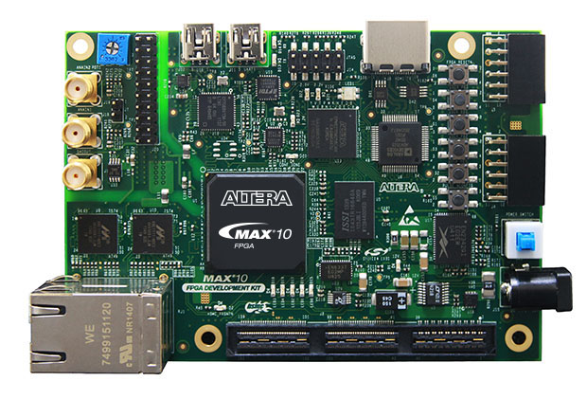
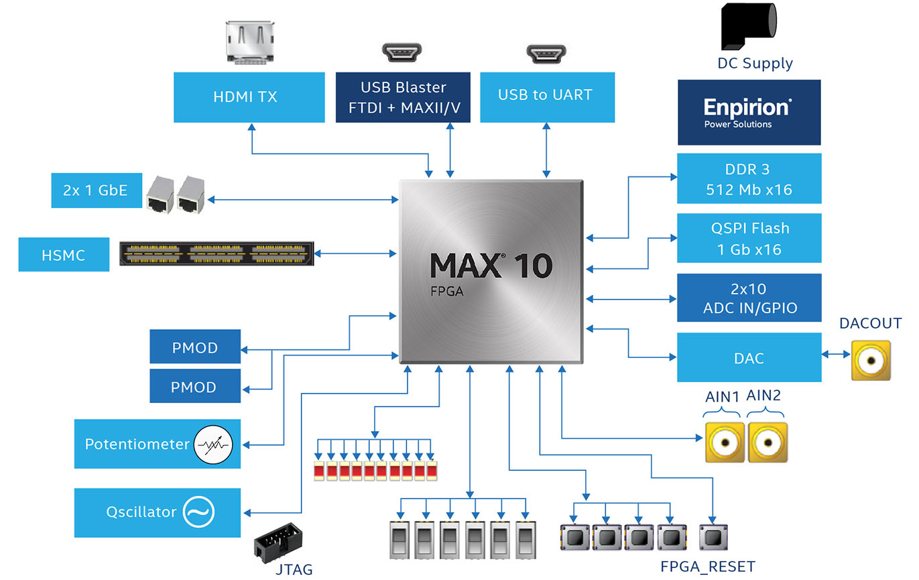
MAX 10 Development Board and Diagram

Slide 20
MAX 10 vs CPLD
MAX 10 is a highly capable FPGA with an on-chip flash configuration memory. For the first time, the on-chip flash is capable of dual configuration. That is, it can hold more than one configuration of the FPGA. Dual configuration brings in features such as fail-safe upgrades, where the “factory” configuration can be retained in one memory partition while a new upgrade is loaded and verified, without risk of corrupting or replacing the previous configuration.
Because MAX 10 is “instant on” (and in this case, “instant” means less than 10ms for the chip to configure itself from on-chip flash), a wide range of system startup, system monitoring, power sequencing, and system management applications are within easy reach – in markets like from automotive communications. The fast boot time operation implies that it is best suited to the task at hand of deploying it as an interface between the HIL system and the ECU.
On the IO front, MAX 10 delivers up to 500 user IOs, and it includes a DDR3 external memory interface for high-performance commodity external storage. This is a considerable amount of IO for a CPLD-class device. All that IO would also make MAX 10 great for bridging applications such as this one.
Since the logic cells (LUTs) are built with SRAM-style logic and configured from flash, we don’t have to pay the “flash penalty” of performance of the FPGA fabric. We’ll get the performance we would expect in a conventional SRAM FPGA in a device that behaves like a non-volatile one.
MAX 10 brings densities up to 50K logic elements, a quantum leap for SRAM-based nonvolatile FPGAs. Lattice’s largest MACH XO3 device, by comparison, weighs in at 6.9K logic elements.

Slide 21
MAX 10 vs MCU
The Nios® II processor is a FPGA-optimized 32 bit RISC Harvard architecture processor (soft) core. As the FPGA device is programmable, the Nios II processor is also configurable— enabling it to meet the exact requirements of any application; in addition the processor peripheral set is also easily configured to meet any application-specific requirement. Intel® MAX® 10 FPGA-based solutions based on soft-core Nios II processors, overcome the limitations of COTS by enabling a unique single-chip embedded system that can be customize for product differentiation and optimization. MAX 10 FPGA’s innovative architecture and Nios II processor’s flexibility provide an unmatched alternative solution for today’s embedded designers.
Single-chip, instant-on capability
Small form factor, integrated devices
Customizable peripheral sets
Real-time processing optimization

Slide 22
MAX 10 vs DSP
DSP is basically processor that is running some code from the memory that is converting some data in the memory and it can also interface some peripherals to interface to the outside world. There is very large variety of DSP processors from small, general purpose to some very specialized and sophisticated models. This processors are not very different from general purpose processors or microcontrollers and line between this groups of processors are not very clear specially with addition of specialized peripherals to available SoC designs.
MAX 10 in other hand is not processor in the basic concept, it is simple digital logic circuit that can be configured to run different operations from logic, signal processing and one can configure FPGA as DSP or general purpose processor.
Basic difference from running the code like in DSP to configuring FPGA for some operation is that FPGA can adjust architecture to predefined process and is not limited to simple process some instructions. Of course one can always combine this two approaches in MAX 10.

Slide 23
Why MAX 10 is ideal for this particular application?
MAX 10 combines the better of all the two worlds, the worlds of a FPGA and a CPLD. And when a soft core processor is thrown into the package, it sweetens the deal.
MAX 10 vs DSP:
MAX 10 has been tried and tested for real time applications and the combination of the NIOS II core and FPGA outperform off-the-shelf processors in system performance.
Good old DSP boards did not really stand a chance in comparison to MAX 10, not only because MAX 10 has DSP blocks built in it, but also because DSP’s serial execution nature and its importance in the complex signal processing use cases, where obtaining precision and accuracy from complex processing is of more importance than agility and speed, stands inferior to MAX 10’s capabilities, as far as this project is concerned.
MAX 10 vs Coolrunner II
MAX10 has a CPLD component in it
CPLD is becoming a thing of the past
MAX 10 vs (ZYBO-Z7 & ZYNQ-7000):
A heavy processor is unnecessary
Speed is of the essence
MAX 10’s parallel process execution nature

Slide 24
Keyless Go
Develop
Test
Implement
Conceive
Overview of concepts and design

Slide 25

NFC Overview
General overview of the set of communication protocols used.

Slide 26
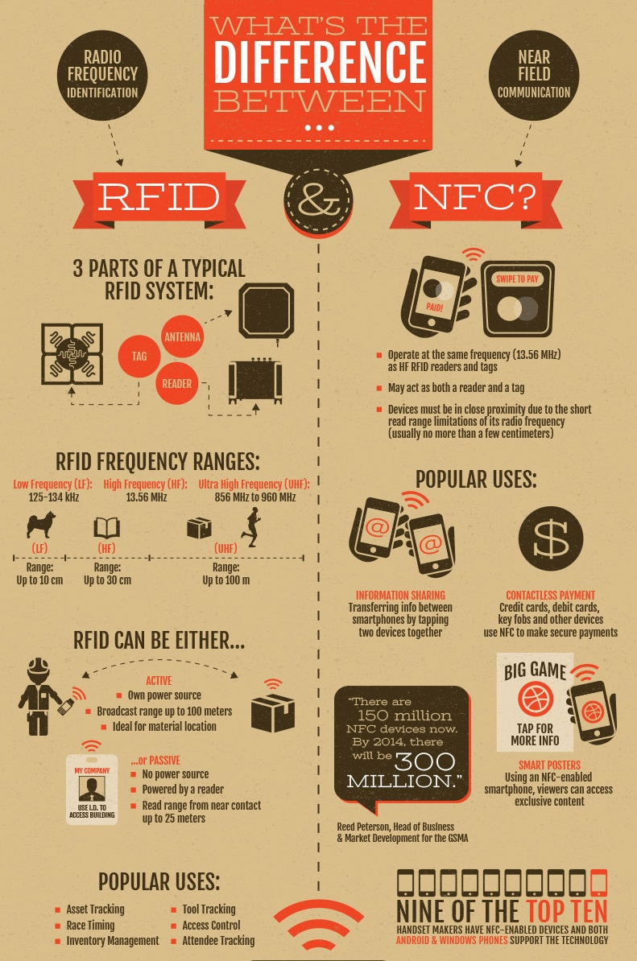
NFC vs RFID
Basic difference between the two most popular methods of uniquely identifying items using radio waves.

Slide 27
Keyless Go
Key near Handle
KG Start-Stop Button
Key Positions
Key
General Description
Keyless-Go is an electronic access and authorization system, in which driver doesn’t have to take the key in hand before boarding or starting the vehicle.
KG system allows to use the vehicle without active operation of KEY.
In KG system key is called as ID-Encoder or ID-Transponder.
In KG system it is enough to carry the key to Lock, Unlock, and to start or stop engine.
All the above operations can be performed after authentication of key. If key authentication is success then user can have access to vehicle otherwise not possible to access the vehicle.

Slide 28
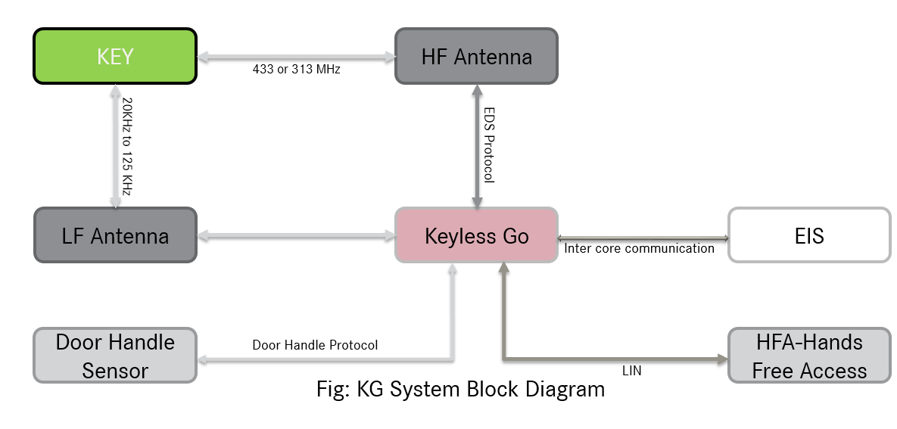
KG System
General Block Diagram .

Slide 29
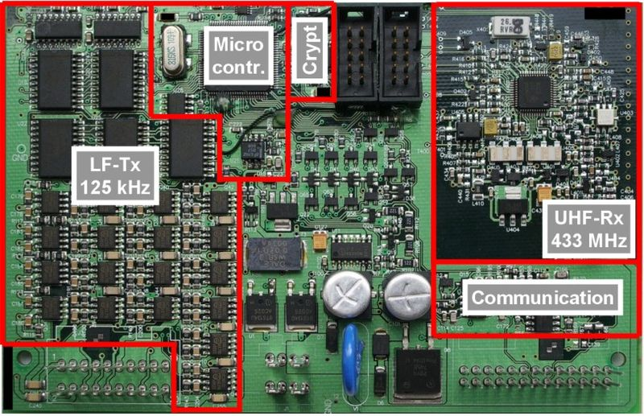
KG ECU
Circuit Units Layout.

Slide 30
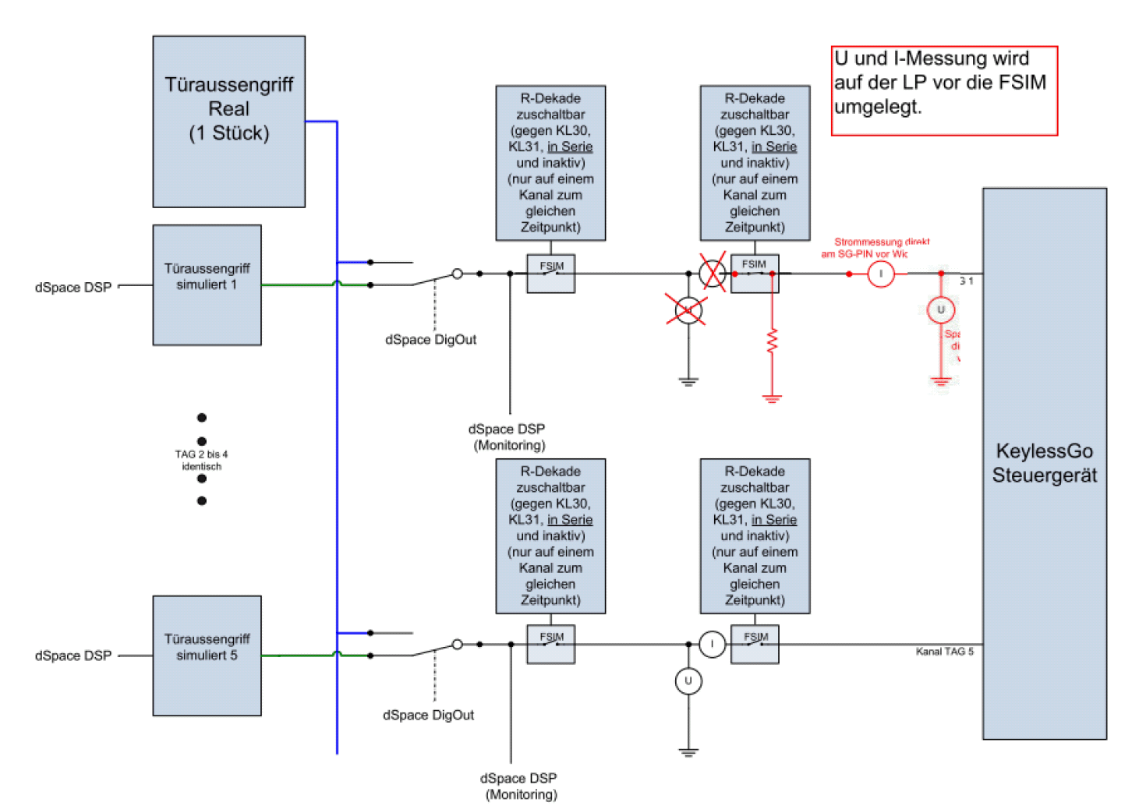
HIL - Blocks
Skeleton without extensions.

Slide 31
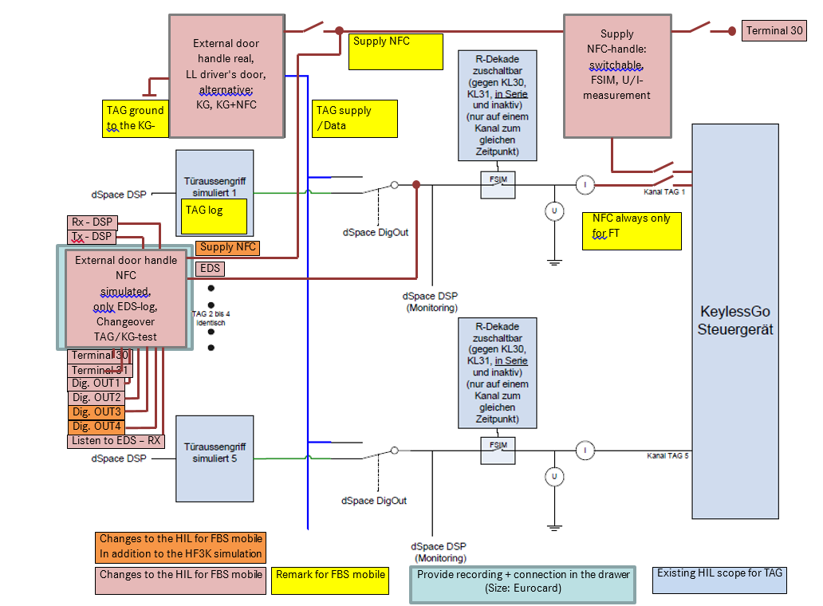
HIL blocks
With extension for NFC door handles/FBS mobile

Slide 32
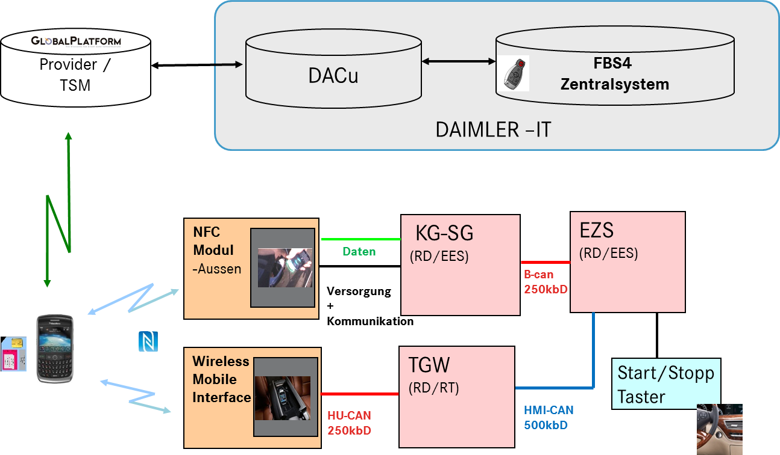
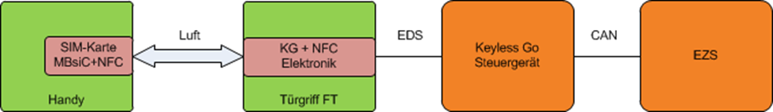
FBS-mobile
System overview followed by the Interface for FBS mobile.
With the special equipment "FBS-mobile", the driver's door handle gets an NFC interface in addition to the existing sensors.
------------------------------------------------------------------------------------------------------

Slide 33
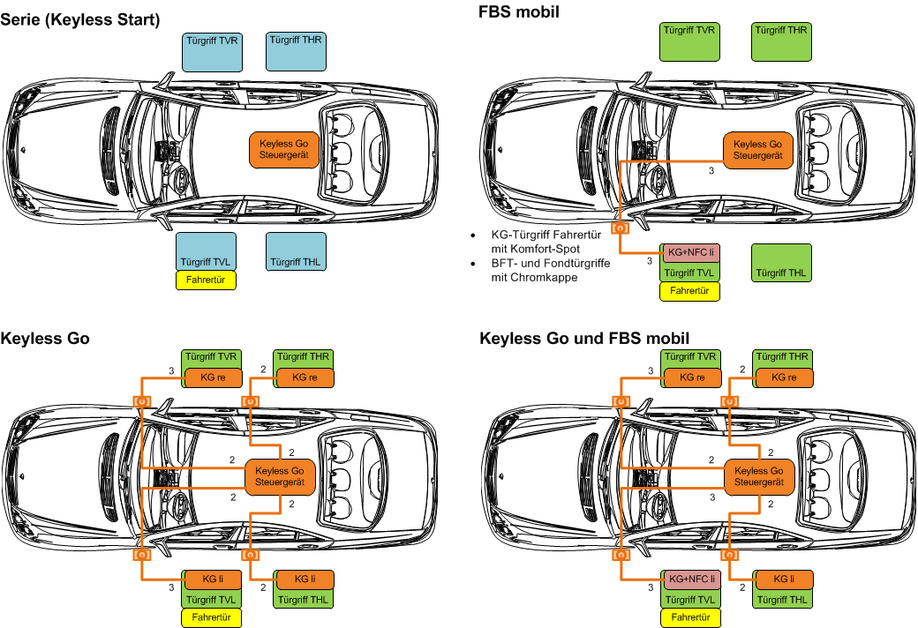
Variant overview
Variants from the basic Serie to displaying the Maximum equipment Keyless Go with FBS-mobile

Slide 34
KG 213
Connection from handle to KGCU
The NFC door handle is connected to the Keyless Go (KG) control unit via a 3-core line.
This connection is always assigned to the driver's door.
All door handle variants KG and KG+NFC of the front doors are connected with the modification for "FBS-mobile" via the wiring harness according to the drive option as driver's door (FT) and passenger's door (BFT). The vehicle side is determined by the global vehicle coding "Right-hand drive/ left-hand drive" in the KG software.

Slide 35
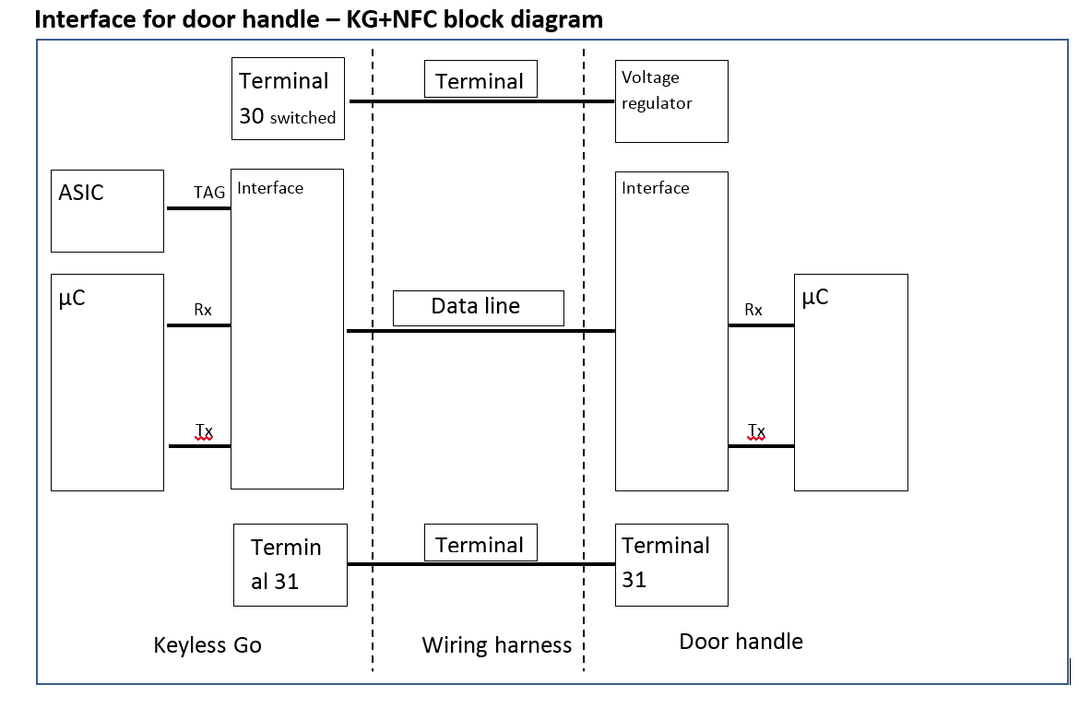
Handle Interface
The execution of the data line is analogous to the EDS between KG control unit and antenna module. The data line is connected via the interface circuit in the KG control unit to the LF-Asic in the KG control unit.

Slide 36
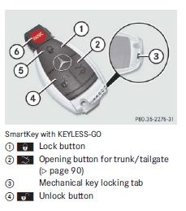
Key
Key buttons
KG Start-Stop Button
Key Positions
Key
Key communication with KG system is wireless communication via LF and HF antennas.
Position of Key is required to perform certain functions and the position of the key is recognized by NF antennas.
KG system key is called as ID-Encoder or ID-Transponder.

Slide 37
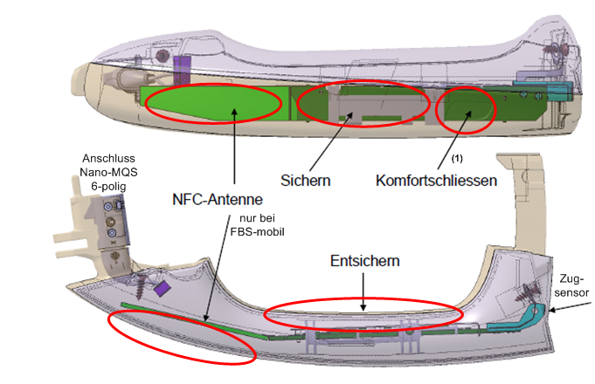
Door handle
sensor position

Slide 38
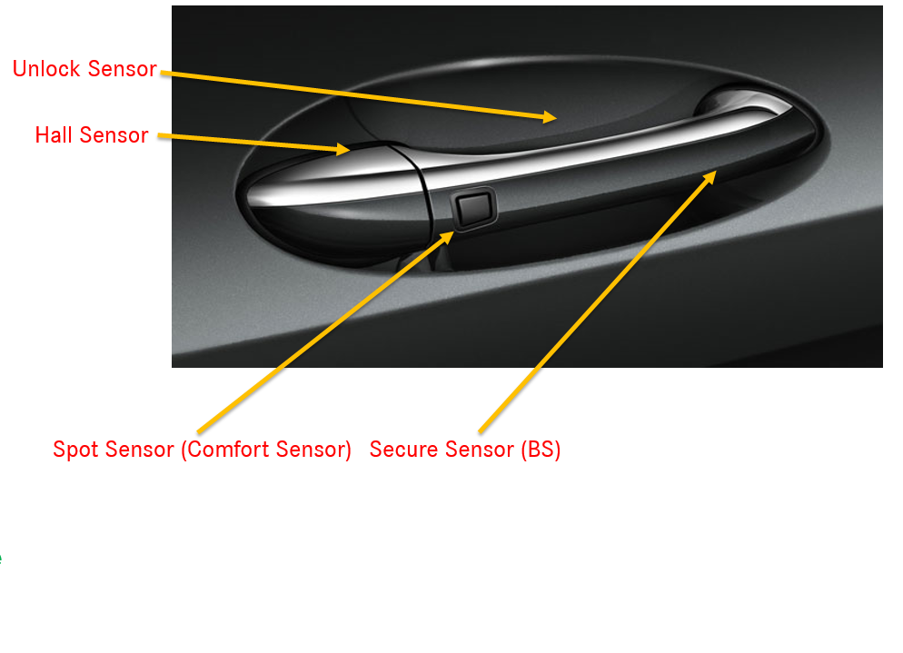
Door Handle
Sensor Functions

Slide 39
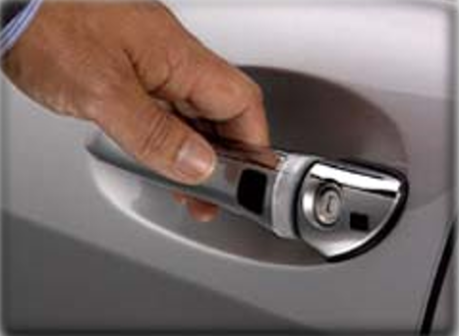
Unlock
Pull
Hall Sensor
Key Near By
NS Sensor
Person with a valid key should be present on the side of the vehicle on which the door handle has been operated.
Door will be unlocked if person with valid key touches the unlock sensor. To open the door handle the Hall sensor should be pulled.
If the actuation takes place in the driver's door, a request for selectively unlocking has to be started else request for global unlocking has to be started.
If the actuation takes place on the front passenger seat or the rear doors, a request for global unlocking must be started

Slide 40

After unlocking
Unlocked
Pull Hall Sensor
Key Near By
Locked
If vehicle door is unlocked by rotary latch from inside of the car and door is closed then for 1.5 seconds car door doesn’t open if hall sensor is pulled.
Outer door handle on the respective vehicle door detects the control desire to open and these signals via the door handle interface to the keyless-go.
Keyless-go must evaluate the received protocol of the outer door handle according to closing logic.
Person with a valid ID encoder should be present on the side of the vehicle on which the door handle has been actuated.
The corresponding Rotary latches are not recognized as open after identifying the Hall-signal within 1.5 seconds.
The door cannot be opened with in 1.5 seconds in this case. After 1.5 seconds if the valid key is present the vehicle door can be open.

Slide 41

Locking
Touch BS Sensor
Touch Comfort Sensor
Key Near By
Locked
Vehicle can be locked by secure sensor or comfort sensor. Locking via secure sensor is only allowed if the vehicle is not globally locked.
One actuates secure sensor for securing vehicle or securing vehicle via comfort in the outer door handle. Outer door handle detects the operating demand to secure and signals this via the door handle interface to the keyless-go.
Keyless-go must evaluate the received protocol of the outer door handle according to closing logic.
Person with valid ID transmitter should be located on the vehicle side where the door handle is pressed.

Slide 42
Comfort functions
Windows Closing
Touch Comfort Sensor
Key Near By
Used for locking as well
When the comfort sensor on the outer door handle is pressed the door will be locked. If the comfort sensor on the outer door handle remains still pressed for 1.5 seconds then comfort functionalities will start.
Those includes closing of roof top, closing of windows and other comfort functionalities.
Person with a valid ID encoder should be present on the side of the vehicle on which the door handle is actuated. Comfort functions will be started after successful authentication of key.
Comfort functionalities will be terminated if the comfort sensor is released on the outer door handle and when terminal/ locking status changes.
Comfort functionalities can also be terminated if any other sensor on the outer door handle is activated.

Slide 43

KG User PSA
Mercedes Benz Keyless Go Comfort Entry System for E / S / GLA / GLC / GLE / CLS Class, induction locking and unlock your car, close windows and rear view mirror automatically after locking car

Slide 44
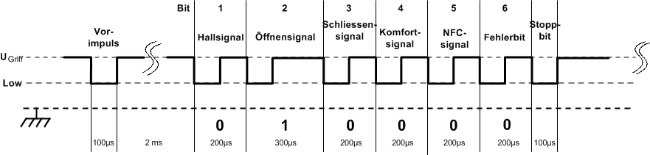
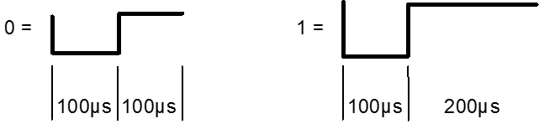
Door Handle Telegram / Log
The door handle sends a pre-pulse before the first telegram. This serves to awaken the current receiver as well as activate the receive mode, so that already the first door handle telegram can be received and evaluated. This first impulse is present only in the first protocol. All other telegrams which are cyclically sent wont have pre-impulse but will have only an "intermission".
Error Bit will be set when there is any invalid length of door handle protocol is detected or any incorrect message is present in any other bit fields of door handle protocol.
The Protocol of the door handle is repeated cyclically for minimum 7ms and maximum of 20 ms.

Slide 45
Keyless go Door handle simulation using INTEL max 10
Using Intel max 10 to act as an interface between the Keyless go ECU and the RTPC, TO SIMULATE THE FUNCTIONALITIES OF THE DOOR HANDLE.
RS-232 COMMUNICATION AS THE SERIAL INTERFACE BETWEEN TRANSMITTING SYSTEM AND THE MAX 10 DEV BOARD. Simulation and implementation strategy are the primary focus of this presentation.
gigabit Ethernet communication interface covered towards the end.

Slide 46
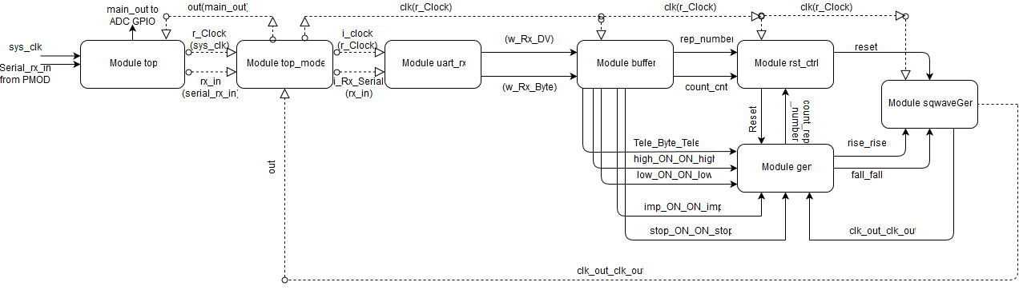
Verilog module control Flow diagram

Slide 47
Verilog codebase config
Configuration :
Controllable Parameters with specifications :
Parameters | Specifications
Telegram + NFC Presence + Reserved | 6 bits + 1 bit + 1 bit respectively
Number of telegram repetition | 8 bits value
ON duration of Telegram’s HIGH bit | Clock * 16 bits
ON duration of Telegram’s LOW bit | Clock * 16 bits
Duration of ‘after impulse HIGH’ region | Clock * 16 bits
Duration of HIGH between successive telegrams | Clock * 16 bits

Slide 48
test case
Following is the test case panout :
Parameters | Specifications | Requirements | Serial Inputs 10MHz Clock
Telegram + NFC Presence + Reserved | 6 bits + 1 bit + 1 bit respectively | HIGH – Schliessen & Fehlerbit , NO NFC | HEX 64
Number of telegram repetition | 8 bits value | 50 TIMES | HEX 32
ON duration of Telegram’s HIGH bit | Clock * 16 bits | 210 microseconds | 7-0 : HEX 34 15-8 : HEX 08
ON duration of Telegram’s LOW bit | Clock * 16 bits | 90 microseconds | 7-0 : HEX 84 15-8 : HEX 03
Duration of ‘after impulse HIGH’ region | Clock * 16 bits | 1.5 milliseconds | 7-0 : HEX 98 15-8 : HEX 3A
Duration of HIGH between successive telegrams | Clock * 16 bits | 5 milliseconds | 7-0 : HEX 50 15-8 : HEX C3

Slide 49
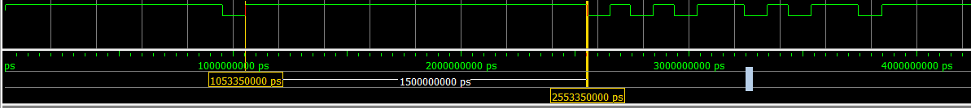
TEST CASE RESULTs
Zoomed Out View : 50 Number of Repetitions
Zoomed IN View : HIGH – Schliessen & Fehlerbit , NO NFC
Region of HIGH between Impulse and First Telegram : 1.5 milliseconds

Slide 50
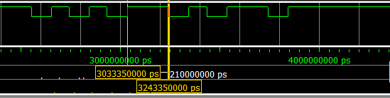
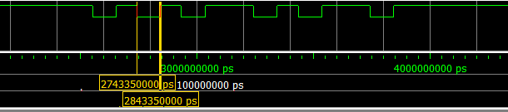
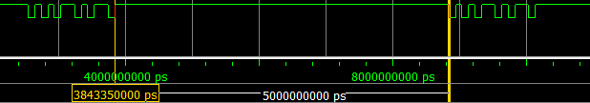
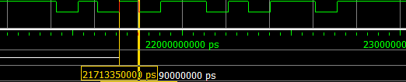
ON duration of Telegram’s HIGH bit : 210 microseconds
OFF duration of Telegram’s LOW bit : 100 microseconds
Duration of HIGH between successive telegrams: 5 milliseconds
ON duration of Telegram’s LOW bit : 90 microseconds

Slide 51
Transmission side : Pc / rtpc
A LABVIEW based UI or a custom Hyperterminal / Teraterm based UI.
Serial Packet Configuration :
[0][data[8]][1] in the format of [start bit][8 data bits][stop bit].
Baud rate has to be the same as of the FPGA Receiver module, 115200 in this case.
If the module uses a 10 MHz clock and has to interface to 115200 baud UART :
10000000 / 115200 = 87 Clocks Per Bit.
Packets of 8 bit generation:
milliseconds/microseconds picoseconds(x) x/clock(100000ps in this case)
[results in]
Y in decimal y into binary [7:0] binary to HEX [send] [15:8] binary to HEX [send]

Slide 52
Verilog implementation in MAX10
Top model of the custom designed Verilog library will be flashed into the MAX 10 board via a INTEL compiler and blaster that coverts the Verilog code into a Digital Logic Design and blasts it onto the FPGA chip.
The top model initializes all the modules included in the library, including the UART module.
The top module has 2 inputs and 1 output. Inputs: 1. Clock 2. Serial receive line Output: Telegram
The compiled Digital Circuit will have the above inputs and outputs.
The clock input to the chip will either flow in directly from the 50Mhz oscillator chip onboard the MAX 10 board, or a PLL modified clock. Thus, the clock input parameter will be connected to the system clock.
The serial receive INPUT line , represented by the Rx_Serial parameter of the top model, will be connected to the receive pin of the UART RS232 module.
The telegram OUTPUT line of the Verilog model will be connected to an ADC-GPIO pin.

Slide 53
Hardware Implementation of MAX 10
The UART RS232 external module will be connected to the PMOD outlet of the MAX 10 board.
The ADC-GPIO pin will be connected to the ECU.
The PMOD UART RS232 external module supplied by Digilent has 6 pins. Namely, Power, ground, Receive, transmit, Clear to Send and Ready to Send .
It should easily fit into the PMOD port (12 pin) of the MAX 10 board.
The PMOD port onboard MAX 10 board, has 10 I/O pins and a pair of ground-power pins.
The Digilent Pmod RS232 (Revision B) converts between digital logic voltage levels to RS232 voltage levels. The RS232 module is configured as a data communications equipment (DCE) device. It connects to data terminal equipment (DTE) devices, such as the serial port on a PC, using a straight-through cable.
The Pmod RS232 utilizes the Maxim Integrated MAX3232 transceiver to allow the system board to communicate with UART compatible PMOD port onboard MAX 10 dev board.

Slide 54
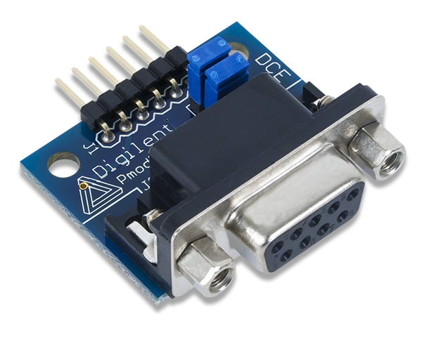
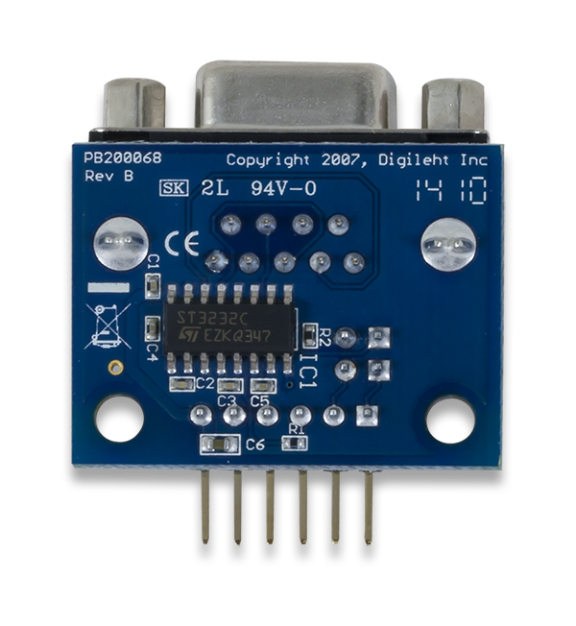
Primary hardware components involved

Slide 55
Single-Port Gigabit Ethernet Communication [Full Duplex]
This design demonstrates Triple Speed Ethernet solution for MAX 10® device family using Altera® Triple Speed Ethernet MAC and Marvell 88E1111 PHY chip on MAX 10 FPGA Development Kit. In this design, the Single-Port Triple-Speed Ethernet MAC connects to the on-board PHY chip through the Reduce Gigabit Media Independent Interface (RGMII).
The design offers the following features:
• Supports programmable test parameters such as number of packets, packet length, source and destination MAC addresses, and payload-data type.
• Supports sequential random burst test, which enables the configuration of each burst for the number of packet, payload data type, and payload size. A pseudo-random binary sequence (PRBS) generator generates the payload data type in fixed incremental values or in a random sequence.
• Demonstrates transmission and reception of Ethernet packets through internal loopback path at the maximum theoretical data rates without errors.

Slide 56
System Architecture
The design example demonstrates fully operational subsystems that integrate the Triple-Speed Ethernet IP Core for Ethernet applications. Figure below shows a top-level block diagram of the reference design implementing the RGMII interface.

Slide 57
Ethernet Packet Generator
Ethernet Packet Generator Block Diagram
Ethernet Packet Generator Output Frame Format

Slide 58
Ethernet Packet Monitor
This Qsys custom component verifies the payload of all receive packets, indicates the validity of the packets, and collects statistics about each packet, such as the number of bytes received. Figure 4 shows a high-level block diagram of the Ethernet Packet Monitor module. This module contains the following components: CRC Checker and Avalon-MM registers.
Ethernet Monitor Block Diagram

